Slide 1
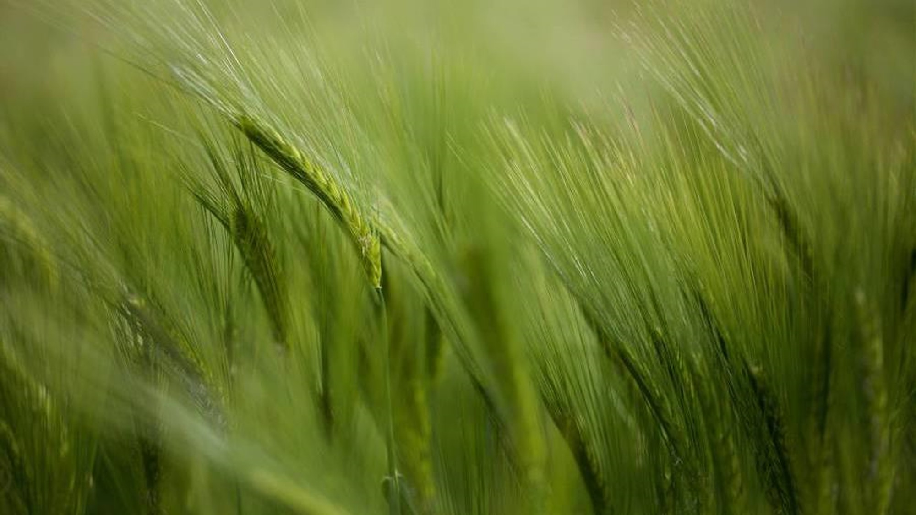
GRAPEGUARD AI AI-Powered Grape Crop Disease Prediction And Pesticide Recommendation System

Slide 2

CONTENTS
Problem Statement
Project Idea
Project Background
System Architecture
Software and Hardware Required
References

Slide 3
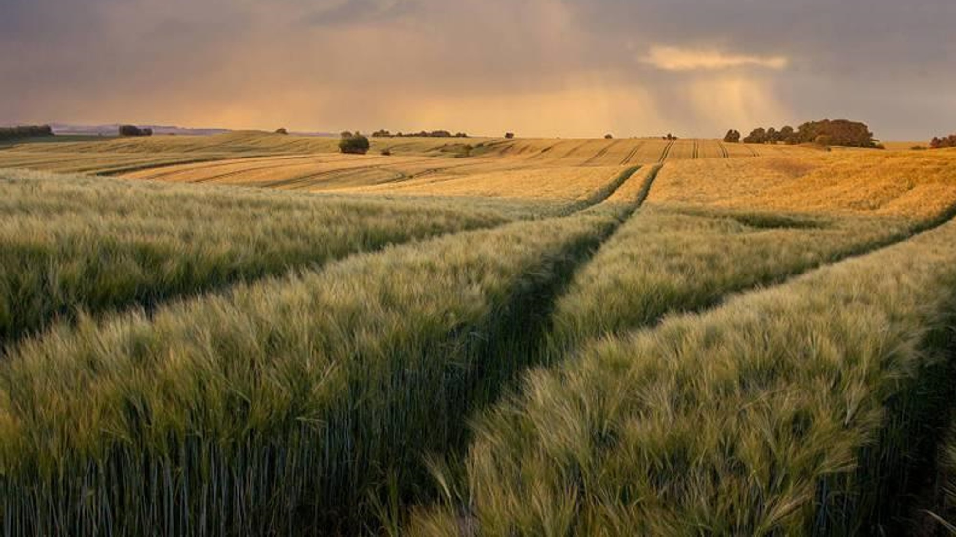
PROBLEM STATEMENT
Farmers growing grapes face severe losses due to fungal and bacterial infections. Limited access to experts and lack of reliable pesticide guidance often lead to pesticide misuse and reduced grape yield. To address this, we propose an AI-powered system that predicts grape diseases and provides reliable pesticide recommendations with expert verification.

Slide 4
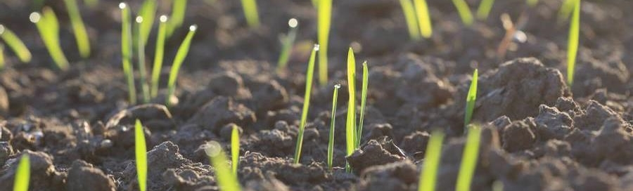
Project idea
This project aims to develop an AI-powered system that helps grape farmers detect common grape diseases early and receive reliable pesticide recommendations with clear explanations. Uses a CNN-based image model for disease detection and LLM for explainable recommendations, RAG retrieves pesticide recommendations from a verified grape-disease dataset, Explainable AI for transparency, and expert verification for accuracy.
Key Features:-
Disease Prediction – Identifies grape diseases from images/symptoms.
Explainable AI – Provides confidence scores, reasoning, and treatment justification for transparency.
Expert Verification –Agriculture experts review and approve AI-generated diagnoses and recommendations.
Pesticide Recommendation (RAG) – Suggests trusted chemical & organic treatments from verified pesticide dataset.

Slide 5
PROJECT BACKGROUND
Limitations of Existing System:-
No Pesticide Recommendation–Farmers need to consult external experts after detection.
Lack of Explainability (Black-Box Models)– Models give predictions without explaining why a disease is detected.
No Expert Validation – Predictions are not reviewed or verified by agricultural experts.
Existing System:-
Plantix App
Limited explainability, does not give clear pesticide usage guidance.
Black-box → farmers just see the result.
2. AgroAI
Uses CNN-based image classification for crop diseases.
Needs huge labelled datasets, fails with low-quality images, not crop-generalised.

Slide 6
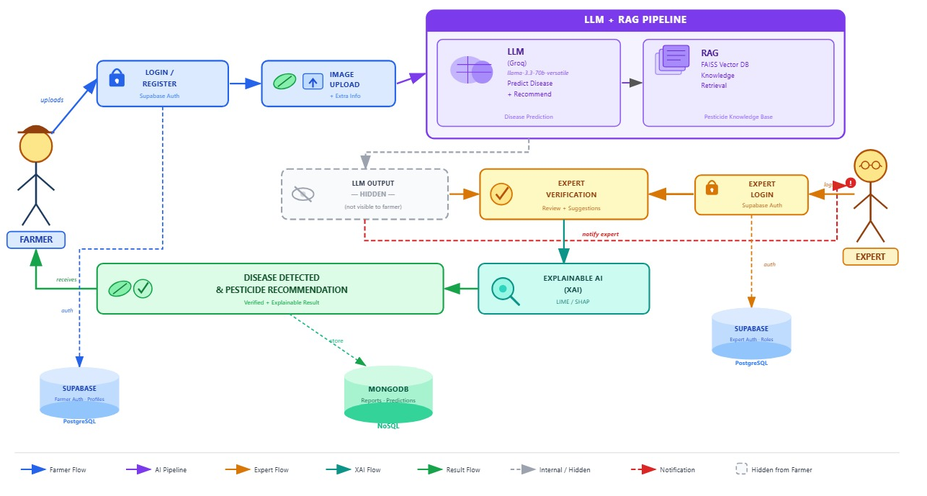
SYSTEM ARCHITECTURE

Slide 7
Software and Hardware Requirements
SOFTWARE.
Programming Languages - Python, JavaScript, HTML, CSS.
Frameworks & Libraries -​ React.js, Axios (API communication), Tailwind CSS / CSS, FastAPI (REST API development), Uvicorn, TensorFlow / Keras (CNN model), NumPy, Pandas (data processing), OpenCV / Pillow (image processing), LLM API / Local LLM, FAISS / Vector search, Sentence Transformers.
Databases -Supabase (PostgreSQL) — Structured data (users, roles), MongoDB Reports & analysis records.
Cloud & Storage - Cloudinary — Image storage and retrieval.
Development Tools – VS Code / PyCharm, Jupyter Notebook.
HARDWARE
Processor – Intel Core i5/i7
RAM - Minimum 8GB
Storage - Minimum 256GB SSD

Slide 8
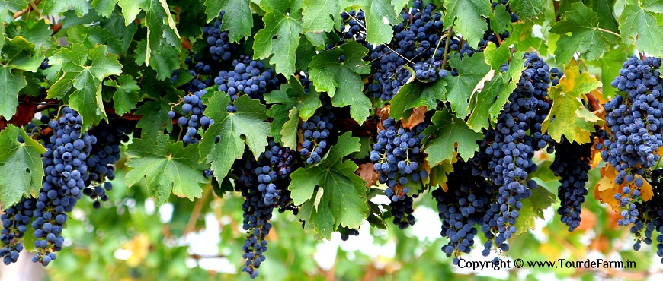
REFERENCES
https://app.readytensor.ai/publications/agentic-ai-for-smart-agriculture-a-multimodal-rag-system-for-crop-disease-detection-diagnosis-mLRSML10lEYd
https://arxiv.org/abs/2503.04788
https://www.mdpi.com/2077-0472/14/8/1359
https://link.springer.com/article/10.1007/s13748-024-00359-4

Slide 9
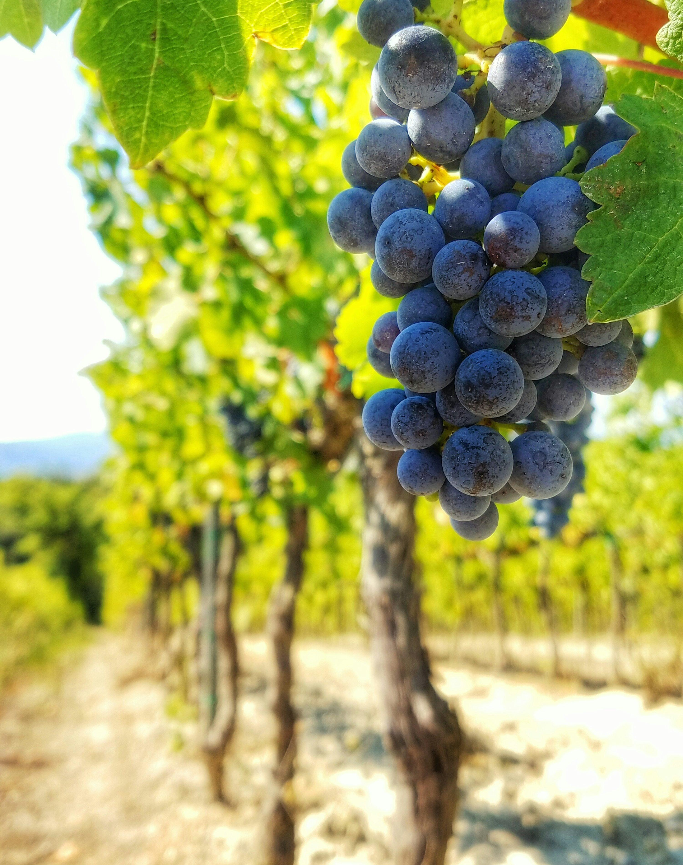
Thank you
Prachi Kishor Sonavane
Siddhi Manojkumar Pande
Shubhangi Arvind Bhuyare
Tejswini Sachin Korade

